Slide 1

CONSUMER GOODS AD-HOC INSIGHTS
Anil Denny

Slide 2
TABLE OF CONTENTS
INTRODUCTION
AGENDA
DATA UNDERSTANDING
AD-HOC REQUESTS WITH SOLUTIONS

Slide 3
INTRODUCTION
Atliq Hardware is one of the leading computer hardware producers in India and well expanded in other countries too. Atliq Hardware has 74 customers, in 27 countries worldwide. Along with Asia Pacific (APAC) region, they also operate in Europe (EU), North America (NA) and Latin America (LATAM). Atliq Hardware has 3 main division of products – Peripherals and Accessories (P & A), Network and Storage (N & S), and Personal Computer (PC).

Slide 4
AGENDA
The management of Atliq Hardware informed the data analytics team to generate some insights regarding customer behaviors to make some data-driven decisions.
Atliq Hardware wants to do ad-hoc analysis therefore analytical team assigned us a task to generate a report by running 10 ad-hoc requests.
We ran 10 ad-hoc requests using SQL to present meaningful insights to our stakeholders which will help our company to make data-driven decisions for their business’s growth.

Slide 5
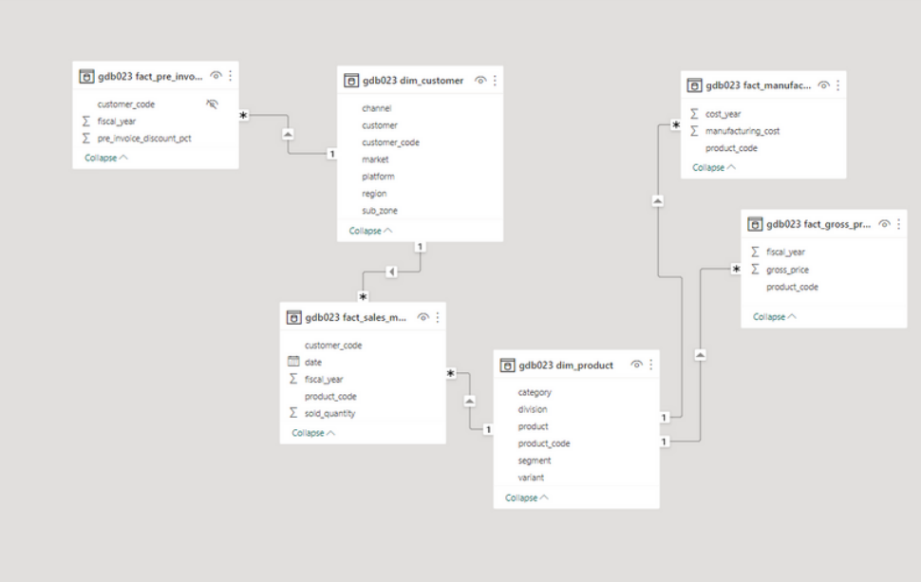
DATA UNDERSTANDING
Dim_customer: Data related to customers
Dim_product: Data related to products.
Fact_gross_price: Gross price of each product.
Fact_manufacturing_cost: Manufacturing cost of each product during production.
Fact_pre_invoice_deduction: Pre invoice deduction of each product.
Fact_sales_monthly: This table contains monthly sales of each product

Slide 6
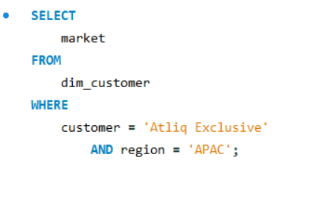
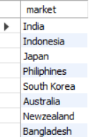
REQUEST 1: Provide the list of markets in which customer "Atliq Exclusive " operates its business in the APAC region.
Req 1
Input Query
Output Table

Slide 7
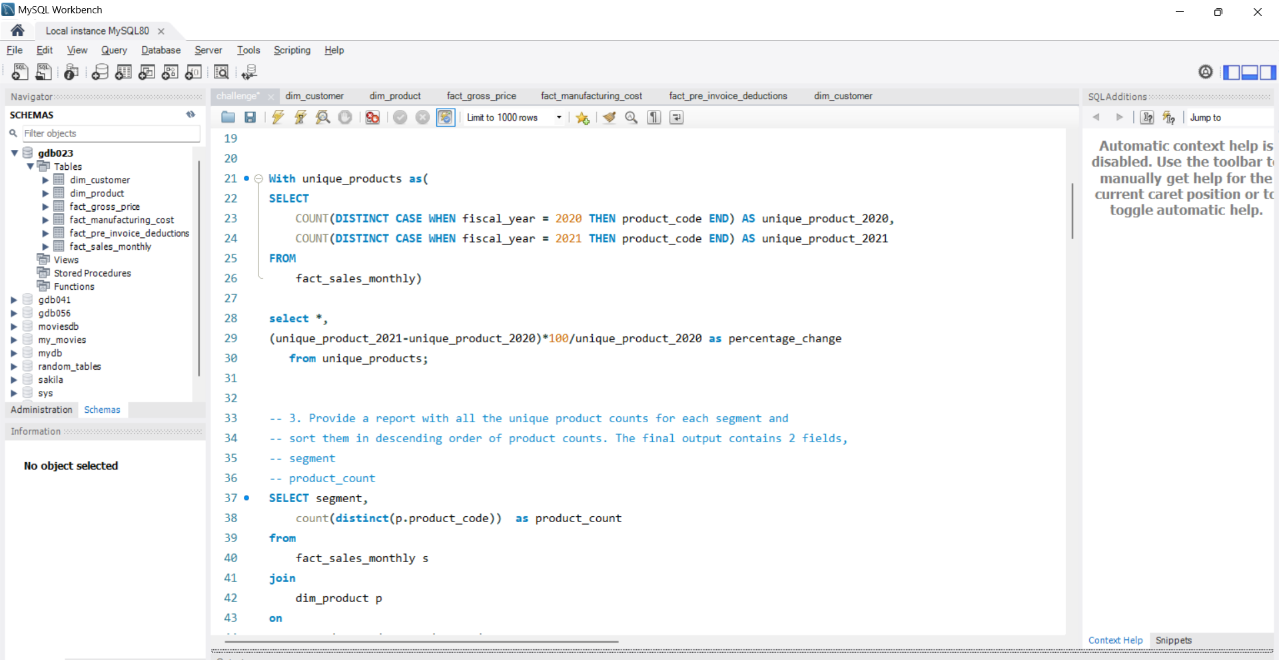
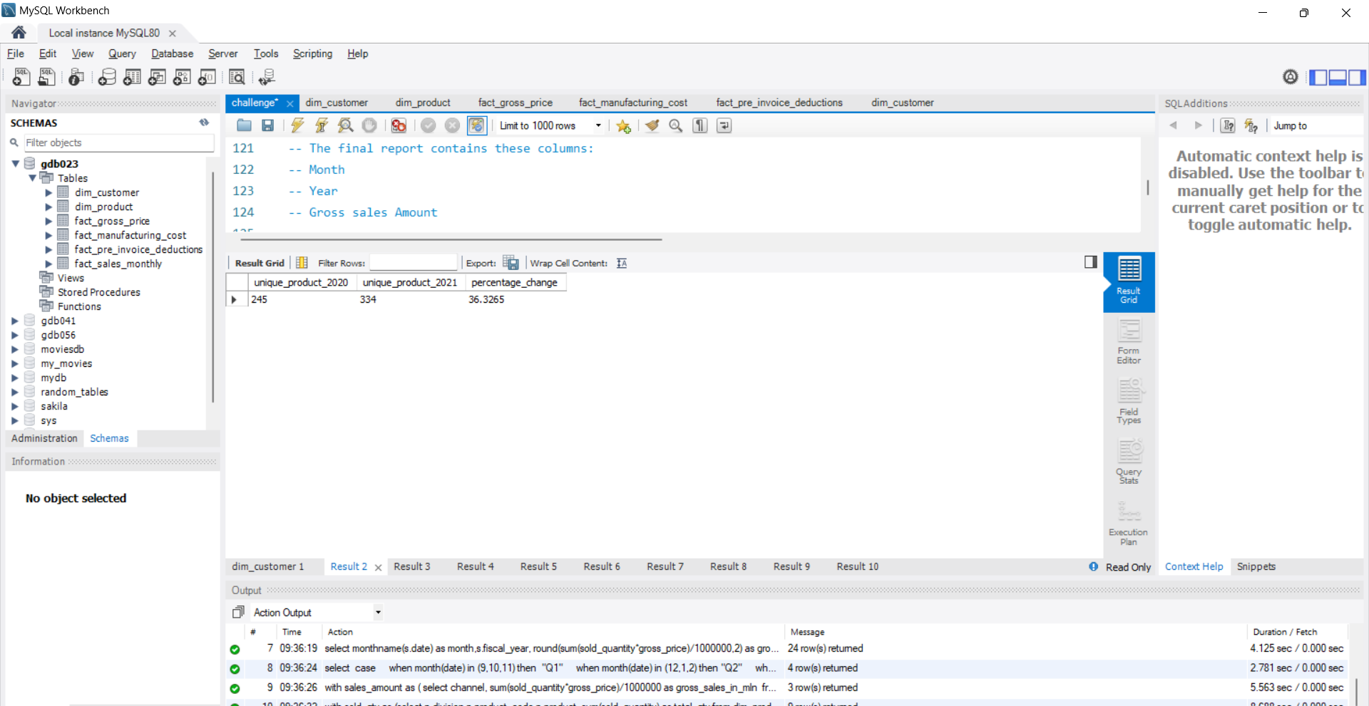
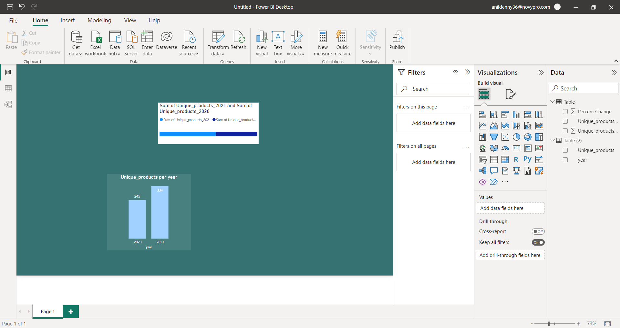
REQUEST 2: What is the percentage of unique product increase in 2021 vs. 2020 . The final output contains these fields: Unique_products_2020, Unique_products_2021,percentage_change
Req 2
Input Query
Output Table
Insights
The table shows that there were 245 unique products in 2020, and this number increased to 334 unique products in 2021
This means that the number of unique products in this category increased by 36.32% from 2020 to 2021.
This is a significant increase, indicating growth in the category over the past year.
Hence more importance should be given to produce more innovative products so as to improve the sales

Slide 8
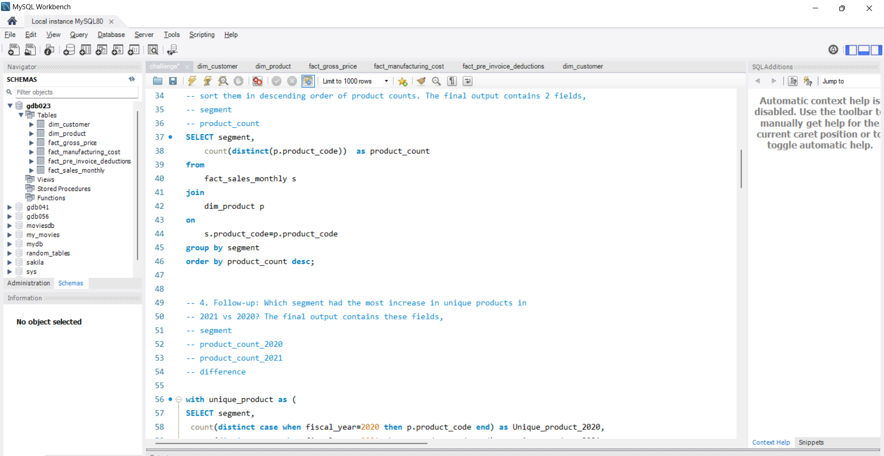
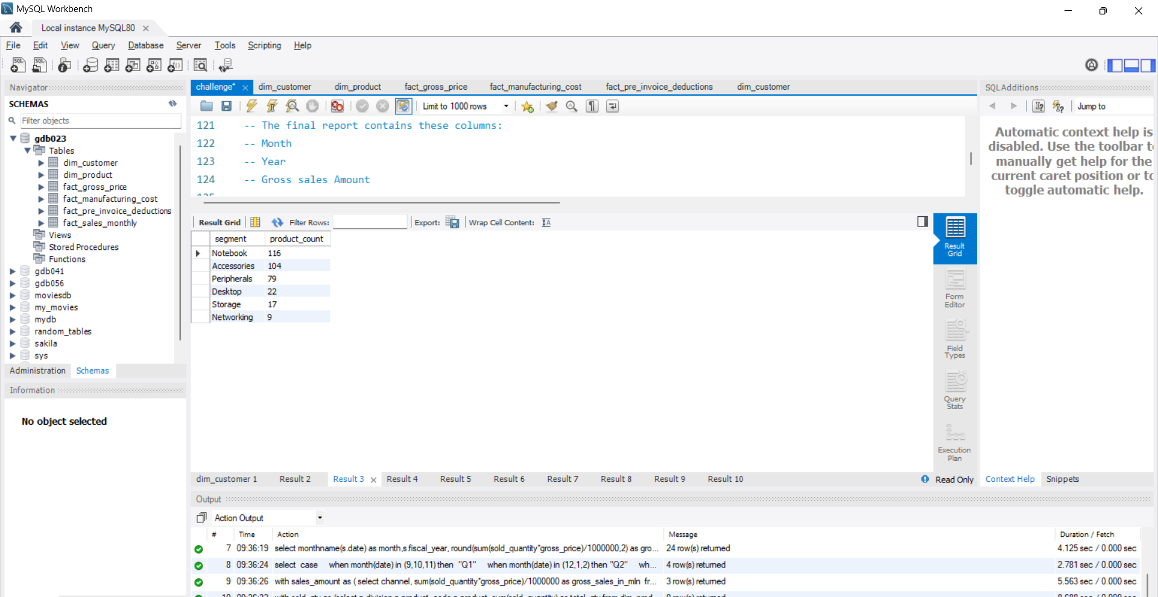
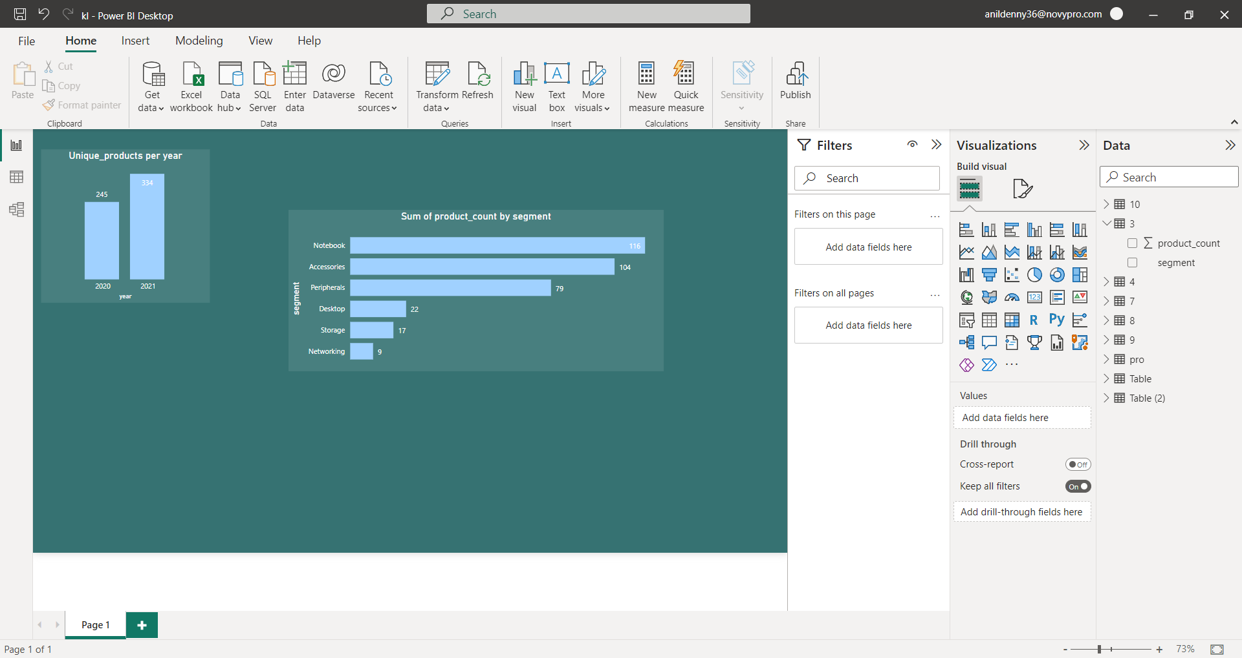
REQUEST 3: Provide a report with all the unique product counts for each segment and sort them in descending order of product counts. The final output contains 2 fields: Segment product_count
Req 3
Input Query
Output Table
Insights
The segment consist of 6 divisions
Out of these 6 segments notebook has the maximum number of unique products with 116 products followed by accessories with 104 products
It is clear that unique products from networking segment is comparatively low therefore Atliq Hardware should prioritize in the production of products under networking segment

Slide 9
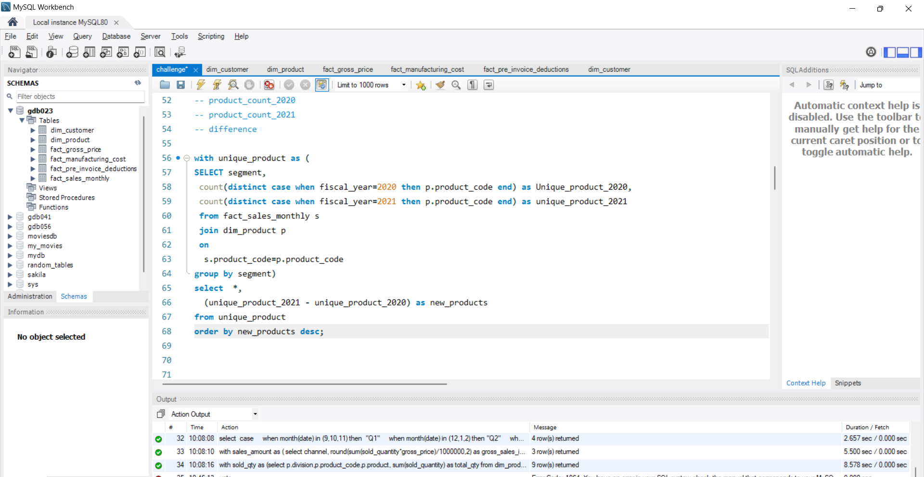
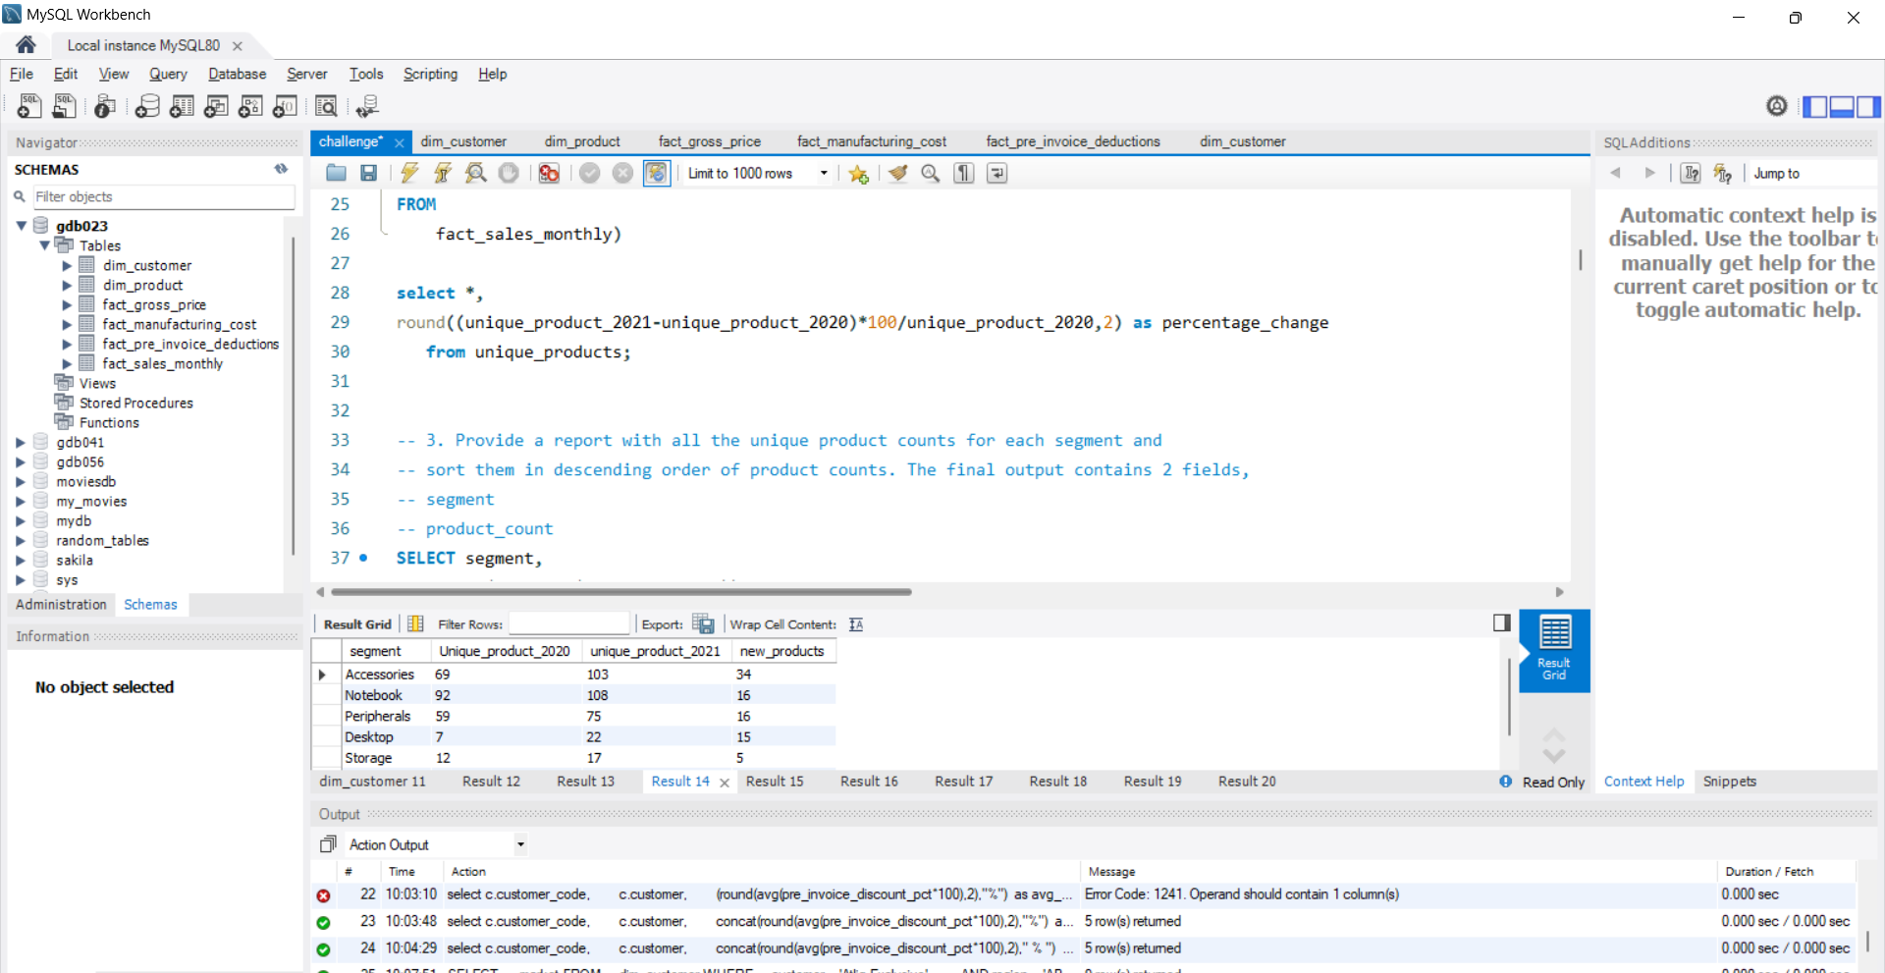
REQUEST 4: Which segment had the most increase in unique products in 2021 vs 2020? The final output contains these fields: segment, product_count_2020, product_count_2021, difference
Req 4
Input Query
Output Table

Slide 10
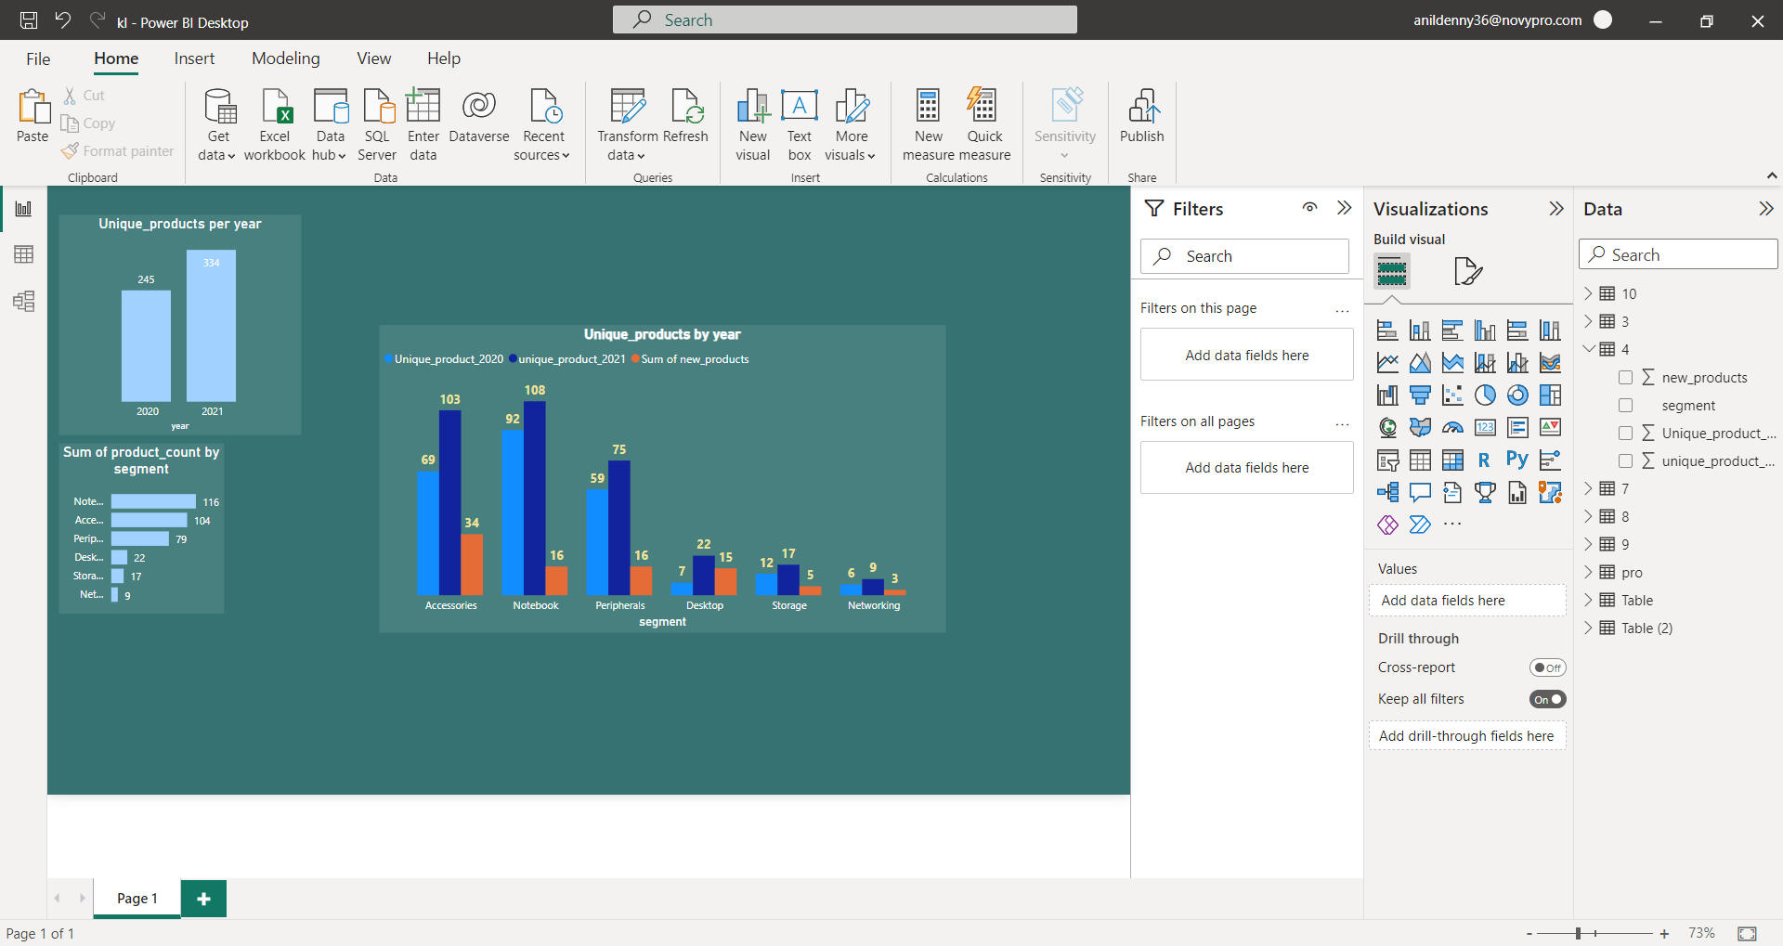
Req 4
Insights
Accessories produced 34 new products when compared to 2020 this is the highest value of new products produced by a particular segment
When looking on the percentage increase Desktop has the highest percentage increase which is about 214.28% increase which implies a positive growth and also denotes the potential increase of products under desktop segment in the upcoming fiscal year
Notebook has the lowest percentage increase that is 17.39%

Slide 11
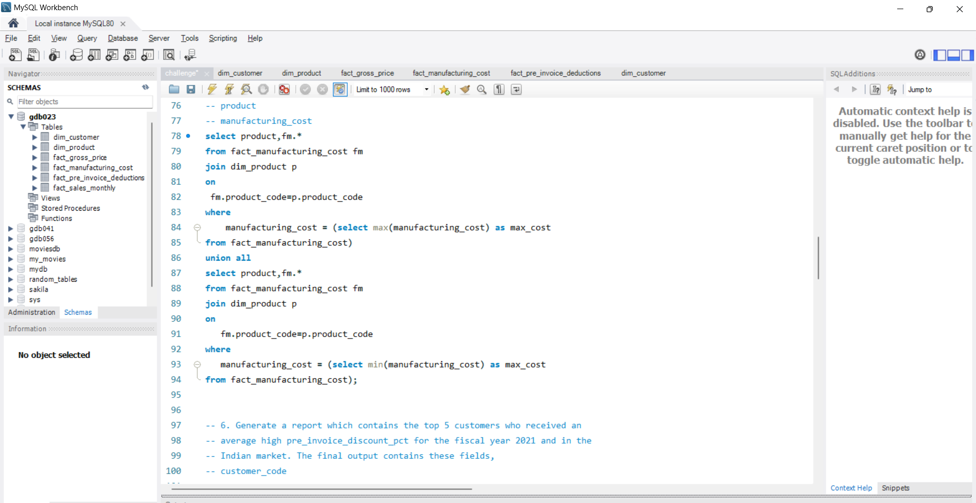
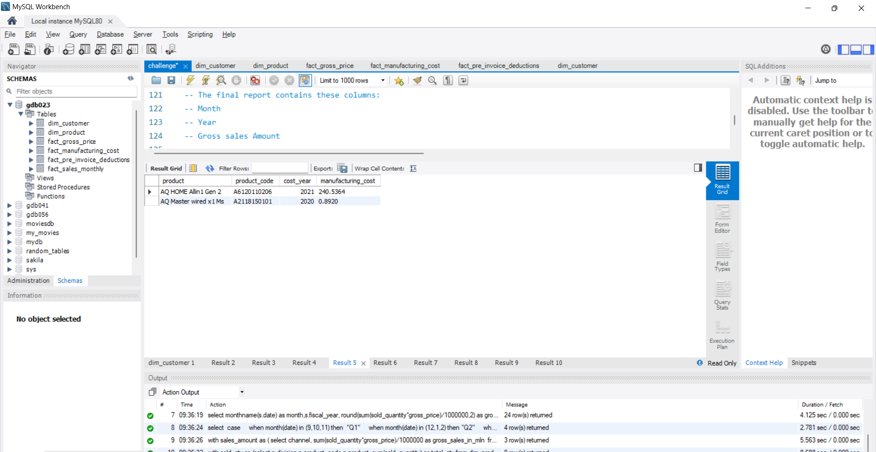
REQUEST 5: Get the products that have the highest and lowest manufacturing costs. The final output should contain these fields: product_code, product, manufacturing_cost
Req 5
Input Query
Output Table
Insights
Maximum cost is $240.5 and Minimum manufacturing cost $0.892

Slide 12
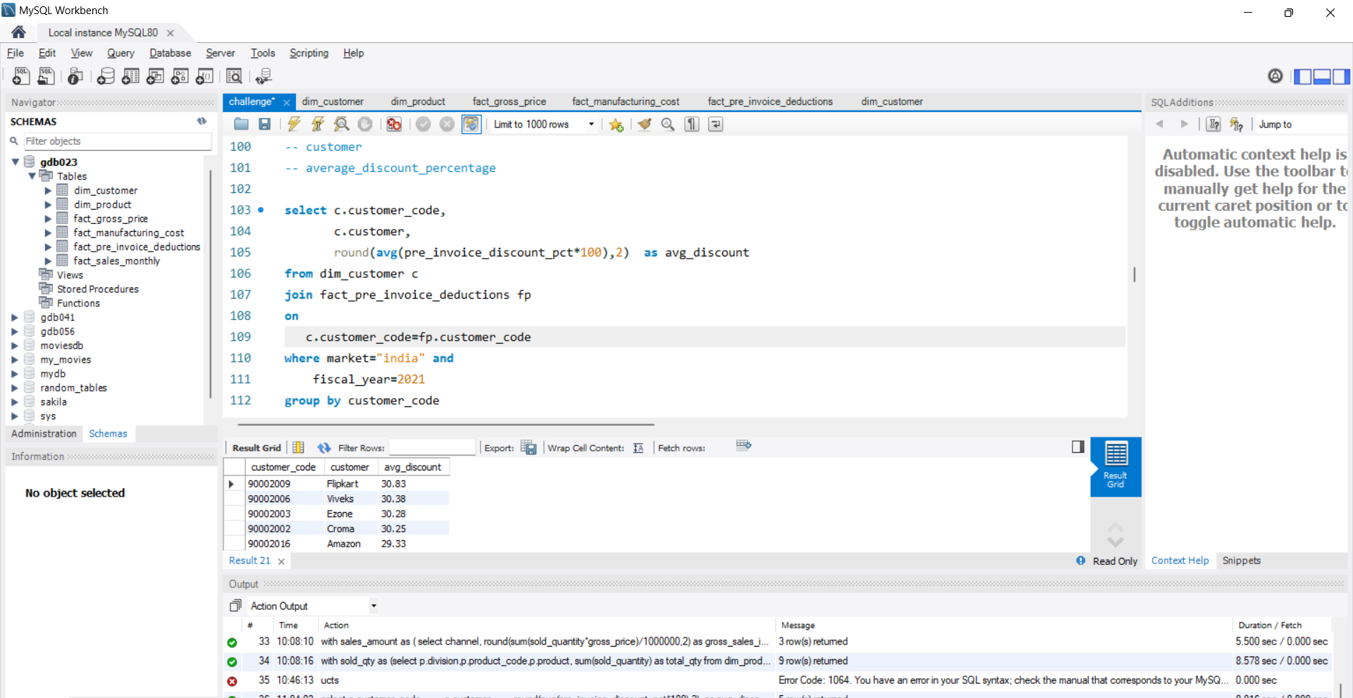
REQUEST 6: Generate a report which contains the top 5 customers who received an average high pre_invoice discount_pct for the fiscal year 2021 and in the Indian market. The final output contains these fields: customer_code, customer, average_discount_percentage
Req 6
Input Query
Output Table
Insights
The average pre invoice discount percentage for top 5 customer for fiscal year 2021 is about 30.21%

Slide 13
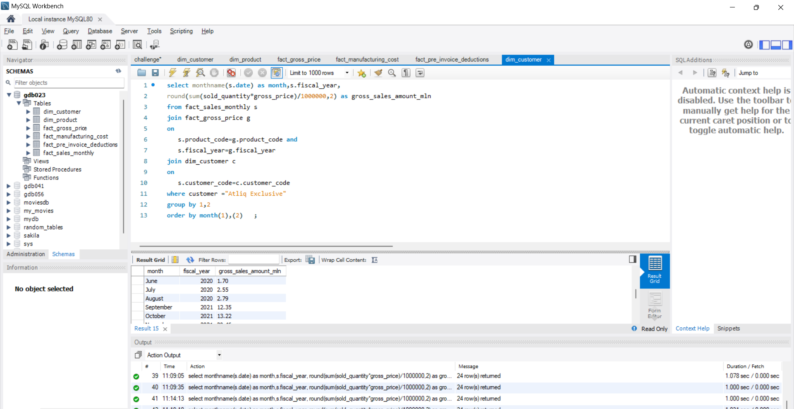
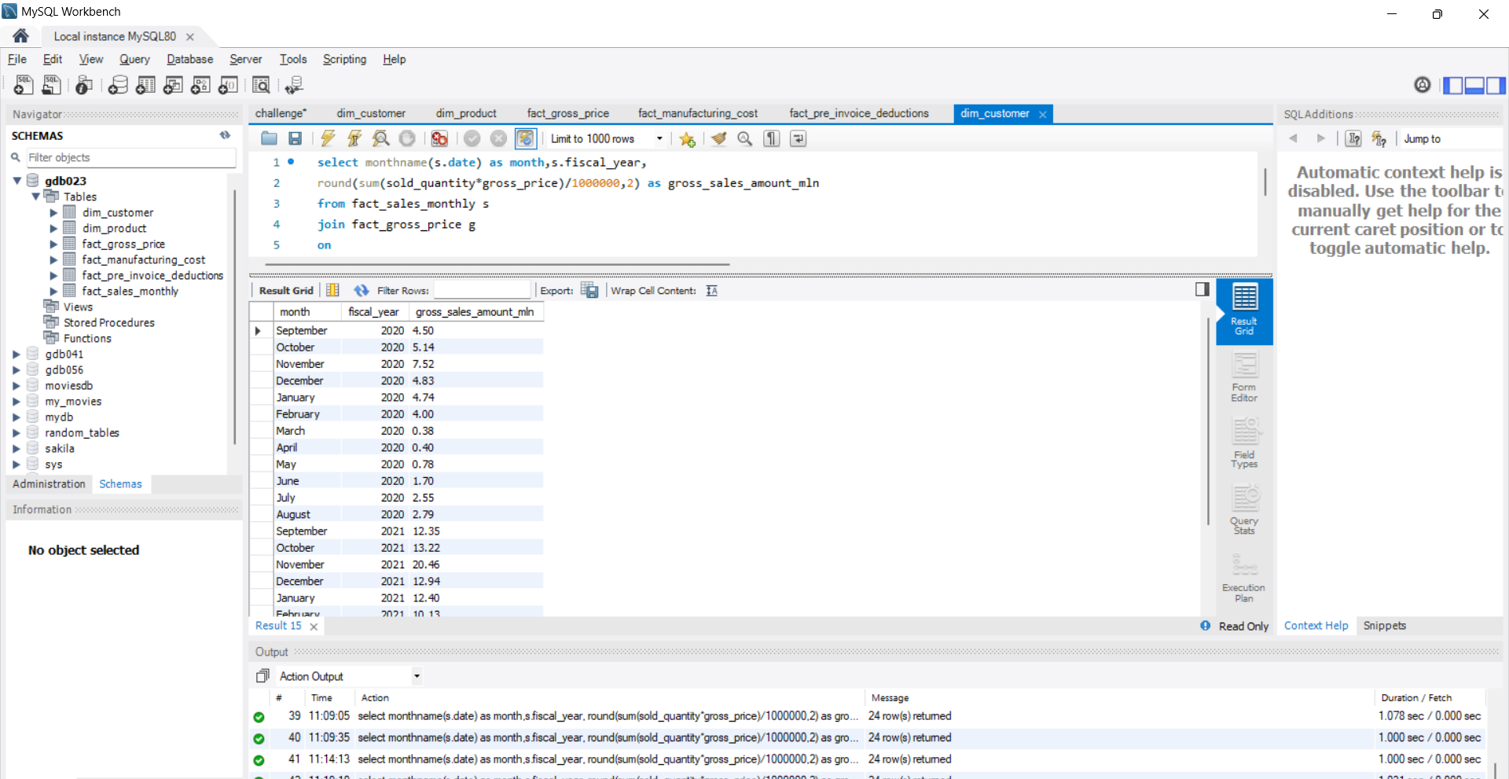
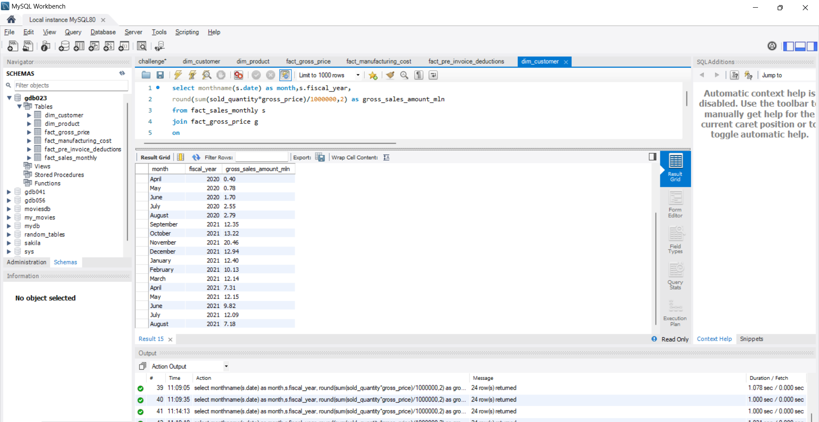
REQUEST 7: Get the complete report of the Gross sales amount for the customer “Atliq Exclusive” for each month. This analysis helps to get an idea of low and high performing months and take strategic decisions. The final report contains these columns: Month, Year, Gross sales Amount
Req 7
Output Table
Input Query

Slide 14
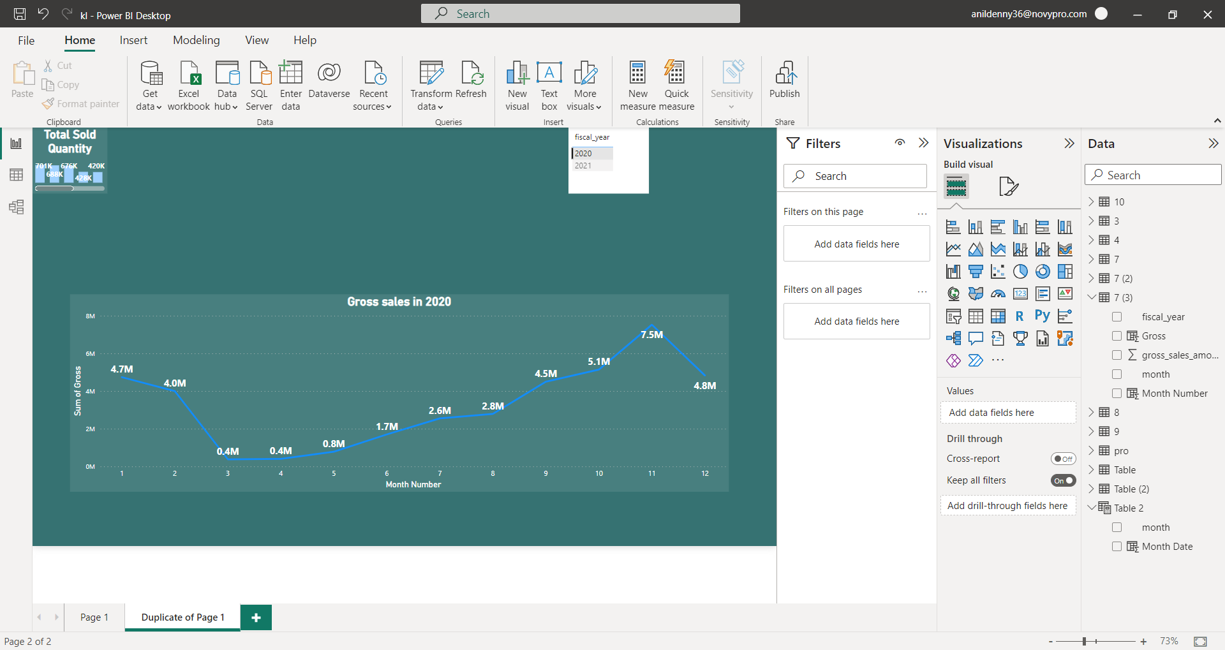

Insights
We can clearly see a boom in gross sales in fiscal year 2021 as compared to 2020
In both the year
1) Max Sales occurs in month of November
2)Min sales occurs in month of March
The trend shows that there is a significant increase in gross sales in the beginning of fiscal year (Sep,Oct,Nov)
From March - May the gross sales is low compared to other years and they belongs to quarter 3 of Atliq’s fiscal year

Slide 15
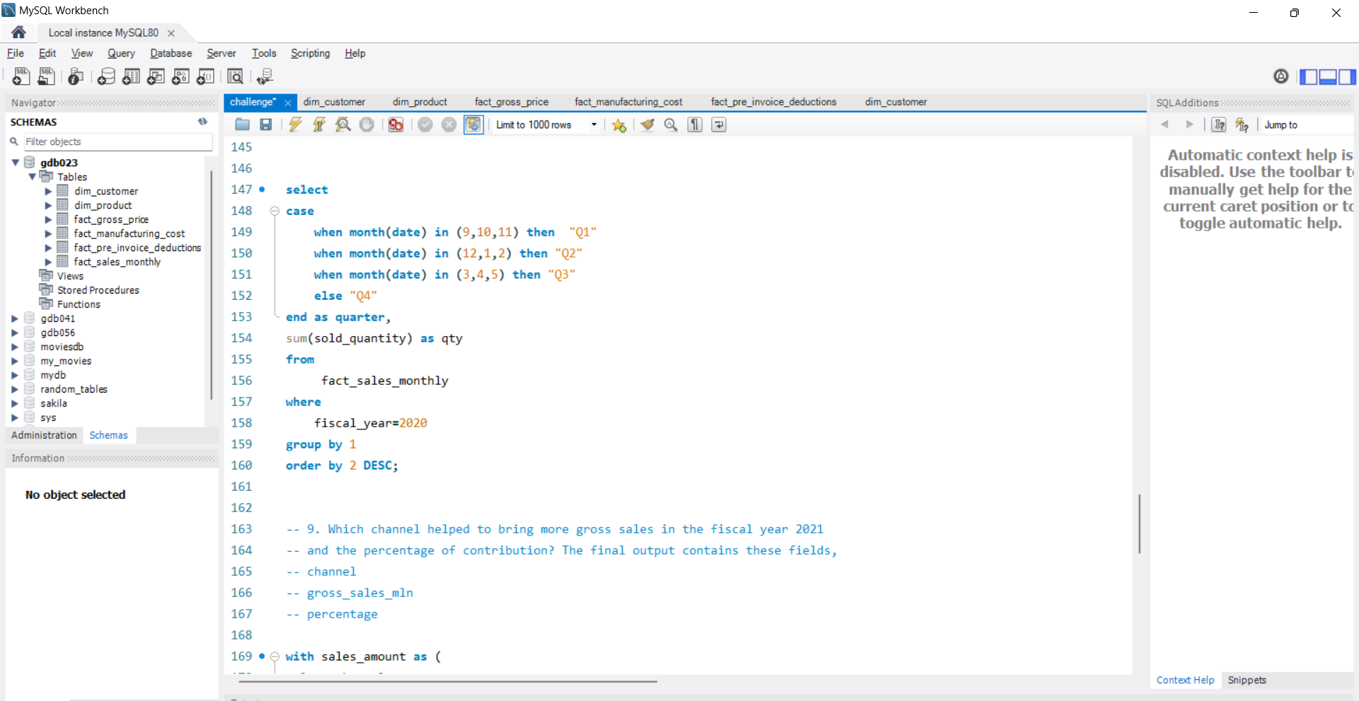
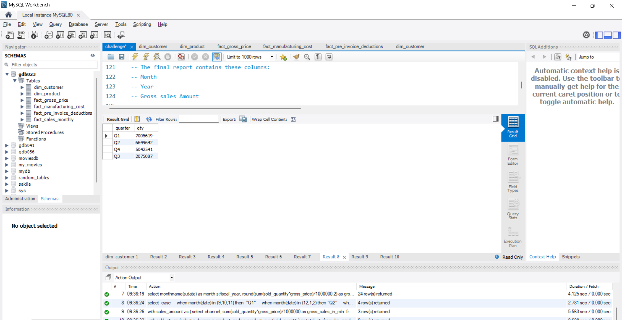
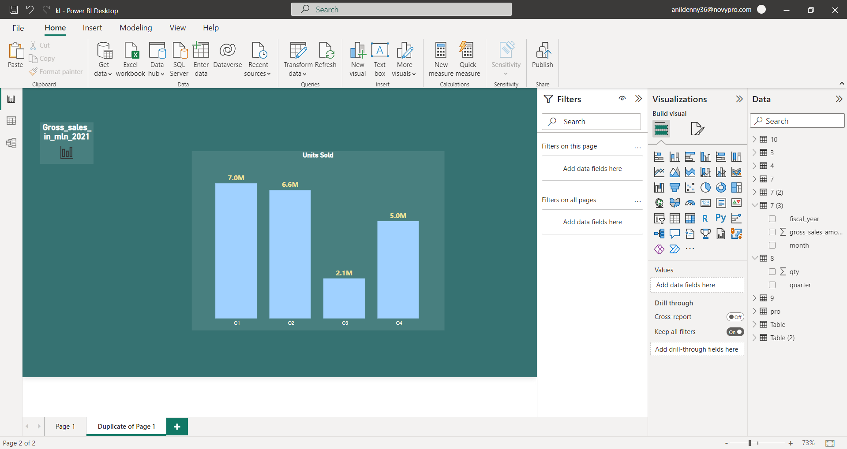
REQUEST 8: In which quarter of 2020, got the maximum total_sold_quantity? The final output contains these fields sorted by the total_sold_quantity: Quarter, total_sold_quantity
Req 8
Input Query
Output Table
Insights
Maximum amount of quantity is sold in quarter 1 followed by quarter 2
Quarter 3 shows a sudden drop in quantity sold

Slide 16
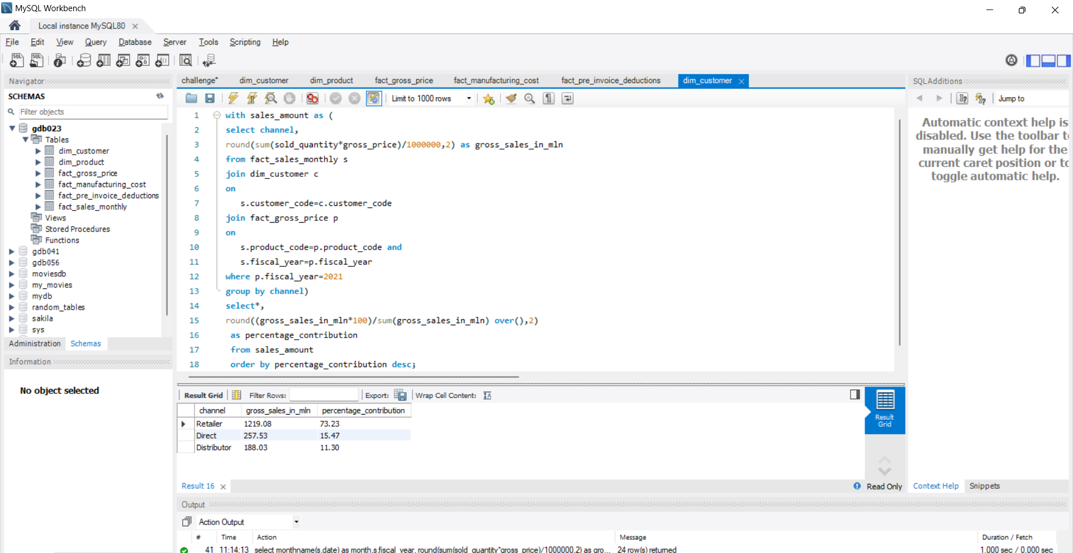
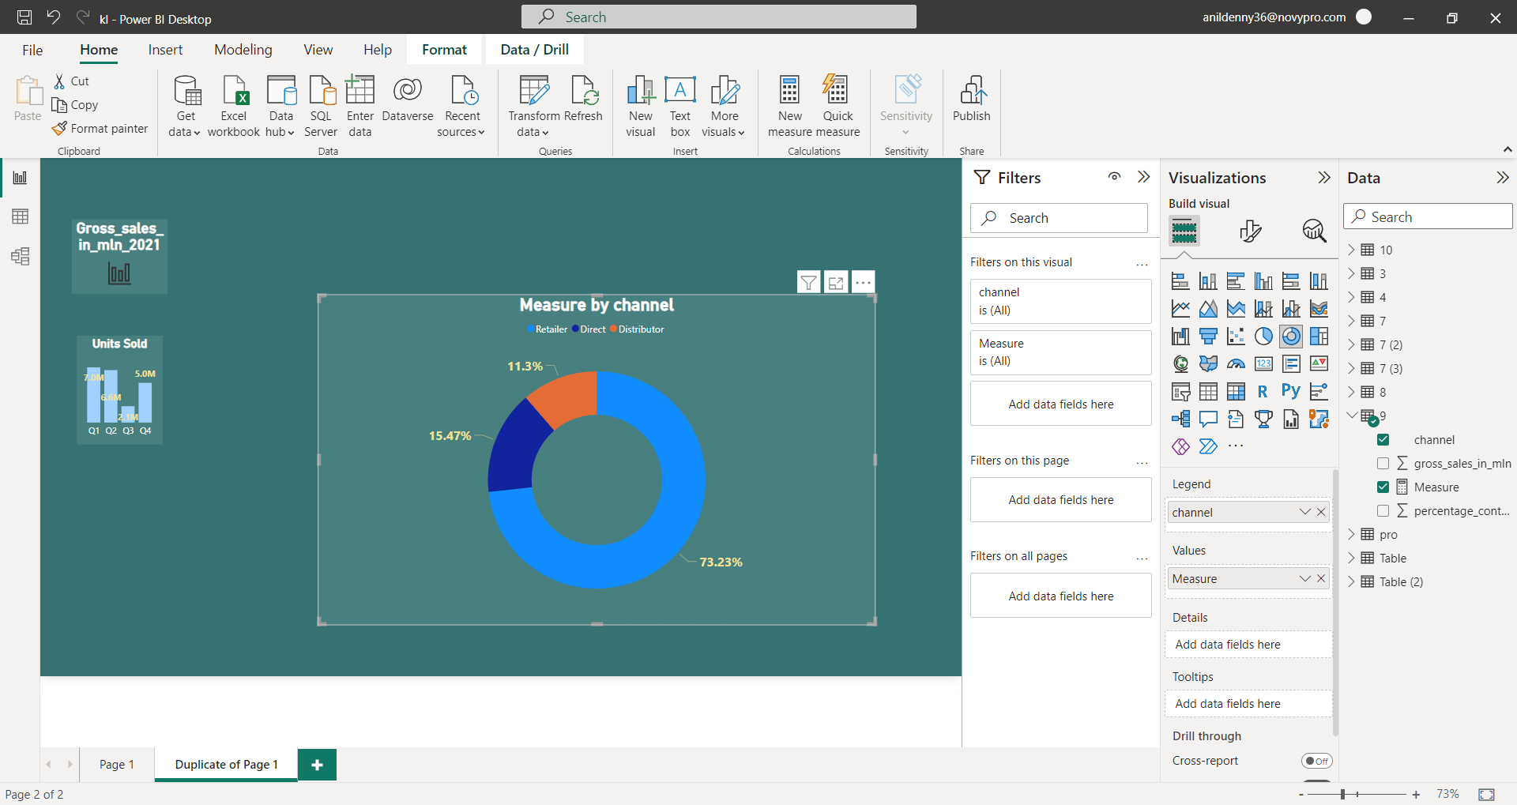
REQUEST 9: Which channel helped to bring more gross sales in the fiscal year 2021 and the percentage of contribution? The final output contains these fields: channel, gross_sales_mln, percentage
Req 9
Input Query
Output Table
Insights
Majority of Atliq Hardware’s gross sales comes from Retailers as they contribute about 73.23% of Atliq’s total gross sales
Maintaining a good connection with retailers can boost gross sales.
Providing discounts to retailers can help to improve the relation and hence improve the sales

Slide 17
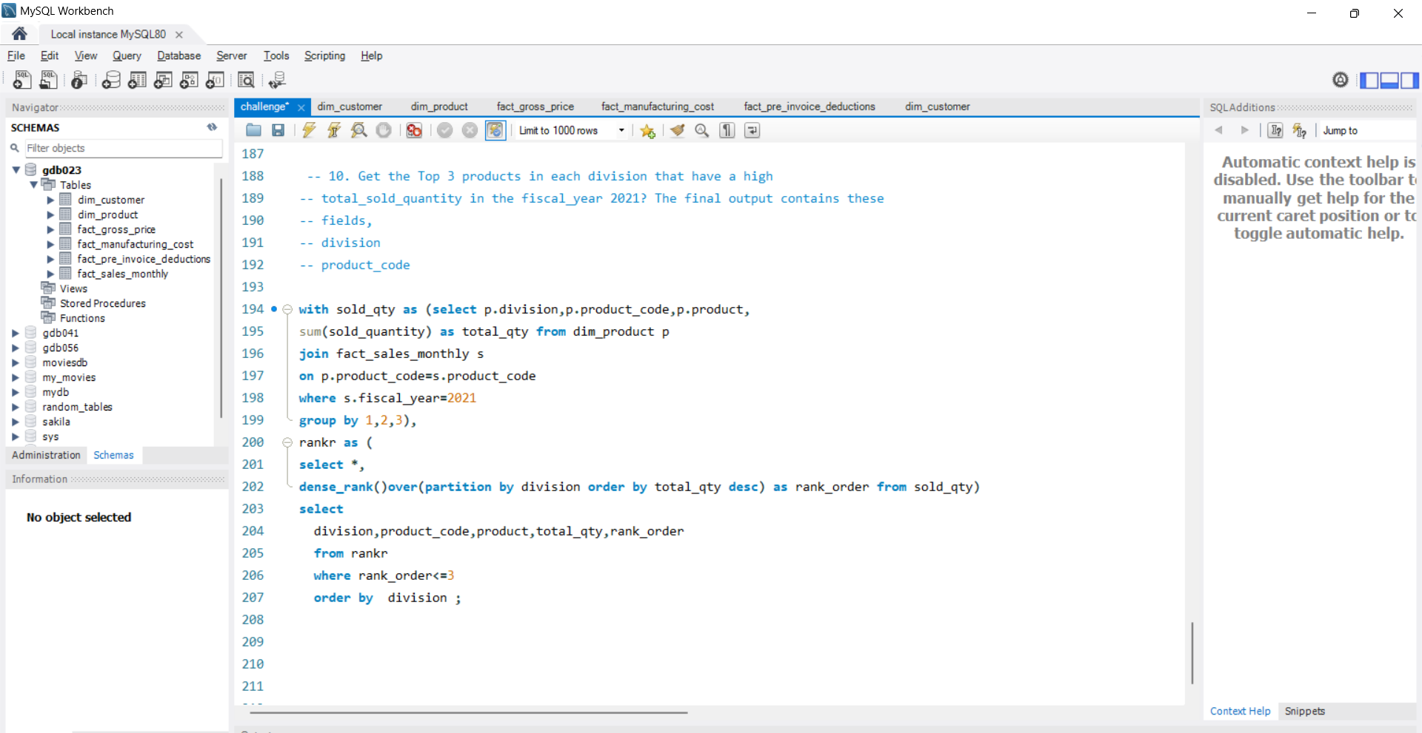
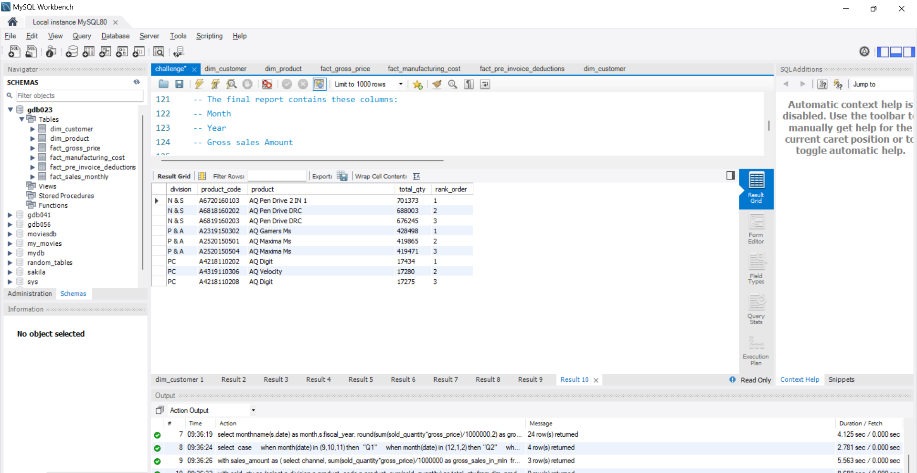
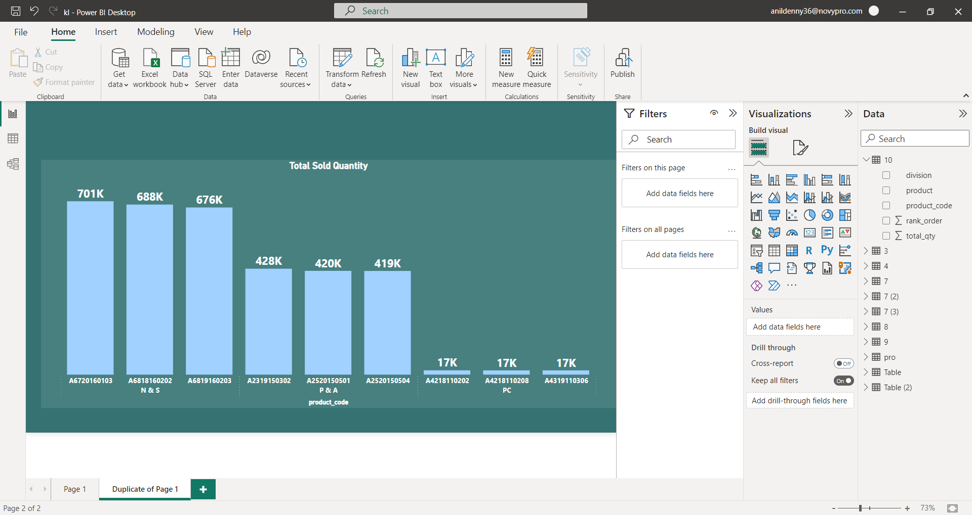
REQUEST 10: Get the Top 3 products in each division that have a high total_sold_quantity in the fiscal_year 2021? The final output contains these fields: division, product_code, Product, total_sold_quantity, rank_order
Req 10
Input Query
Output Table
Top products under each division
Network and Storage (N & S) – AQ Pen Drive 2 IN 1
Peripherals and Accessories (P & A) – AQ Gamer
Ms Personal Computer (PC) – AQ Digit

